Slide 1


SVM
17th Oct 2022

Slide 2
Perceptron
Linear Model – Learning Algorithm
Computationally simple
Drawback
How many iterations ?
Is the solution optimal ?

Slide 3
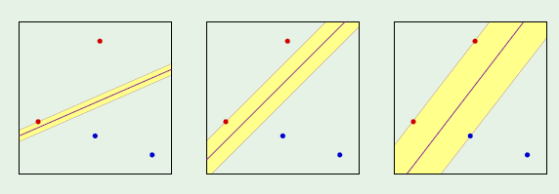
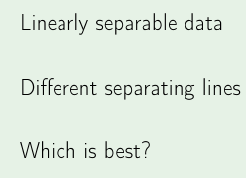
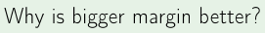
Choice of Separators

Slide 4
Hypothesis-Dichotomy
Differences
If Hypotheses result in same classification, then they get counted in a single Dichotomy
Theoretical guarantees on #Dichotomies
PAC Learning possible if #Dichotomies possible for a given “N”, grows utmost as a polynomial function of #Dichotomies – check !!

Slide 5
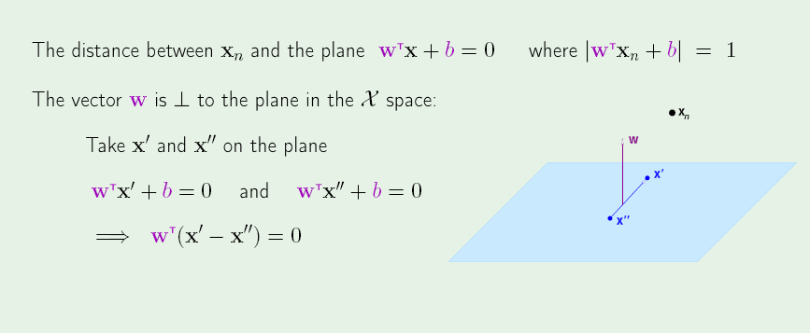
Margin computing
Normalizing the plane (the nearest point must be at a distance 1). The eq of plane won’t change because the magnitude of w doesn’t matter

Slide 6
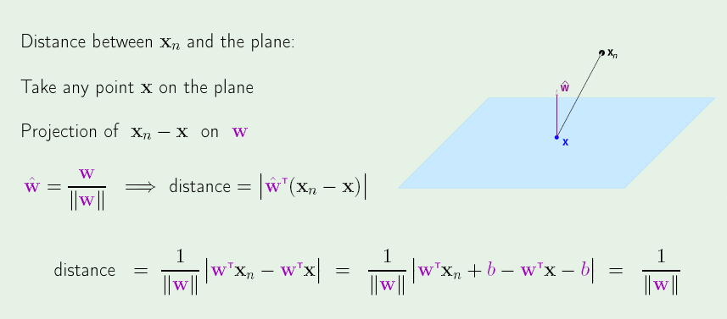
Margin computing

Slide 7
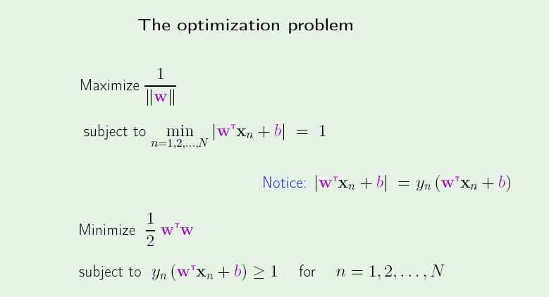
SVM-Framework
Since we are considering only correctly classified points, the sign of both terms must match

Slide 8
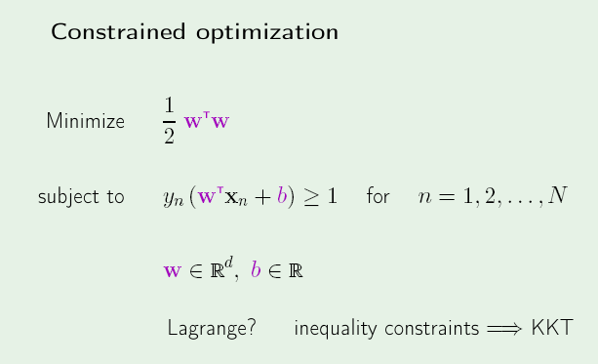
SVM-Framework

Slide 9
Detour - Optimization

Slide 10
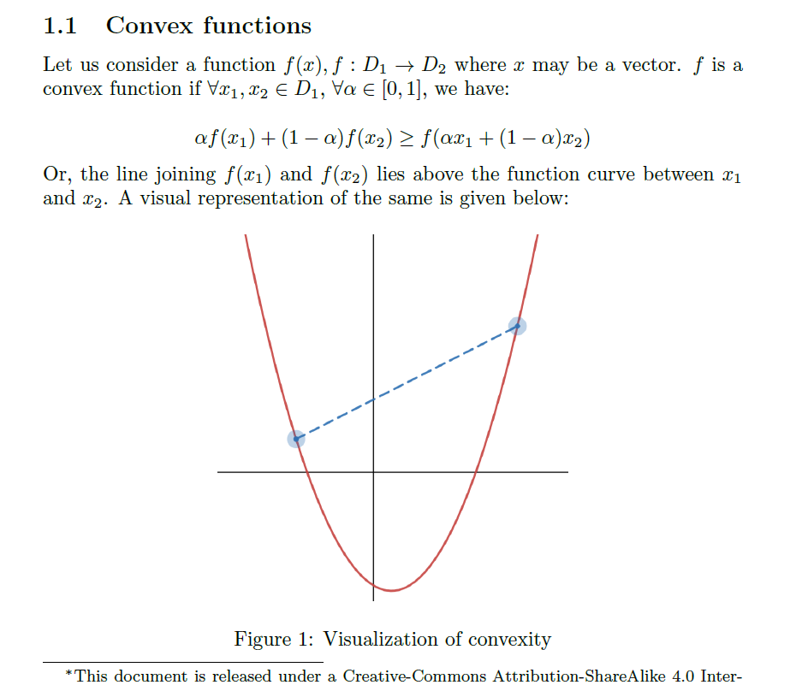

Slide 11
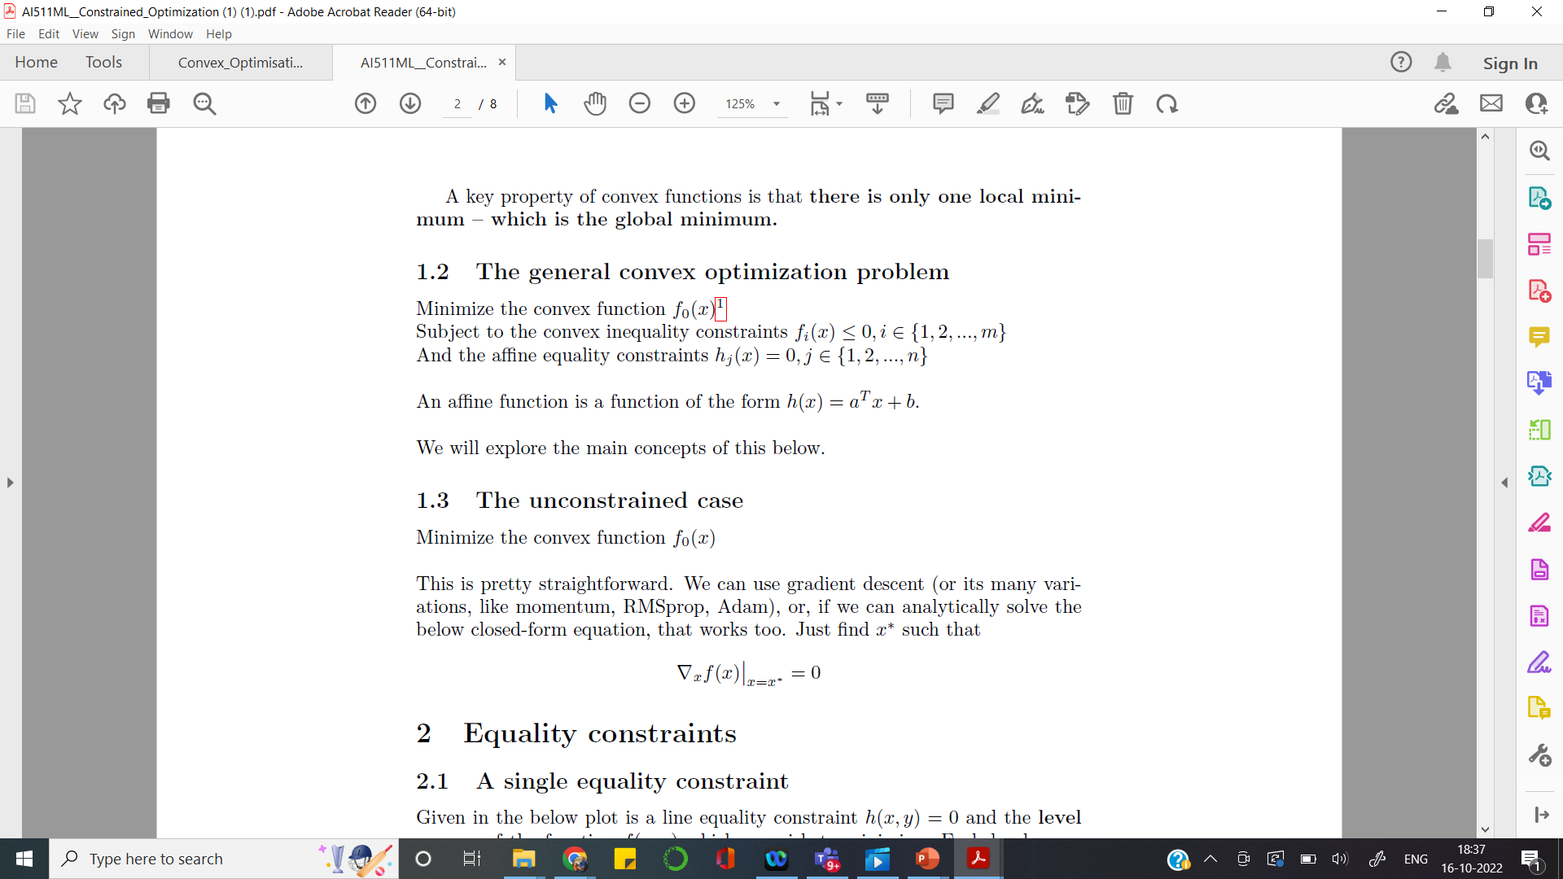

Slide 12
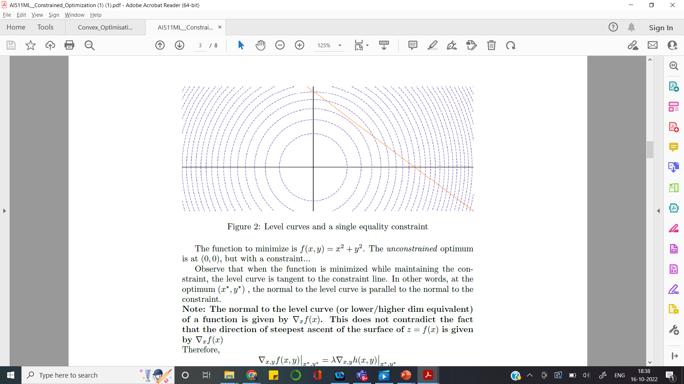
Level curves
Level curves for f(x,y) = x² + y²
Say, we need to minimize f(x,y)
The unconstrained solution is (0,0)…. may NOT be practically useful !!

Slide 13
Constrained Optimization
Subject to Equality constraint, Say h(x) = C

Slide 14
Constraint - Equality

Slide 15
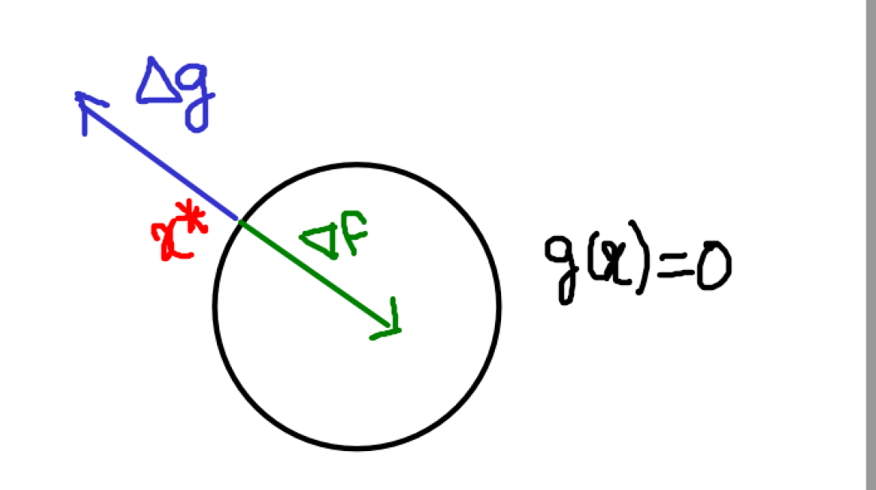
Solution for Equality constraint

Slide 16
Constraint – Equality
Max/Min f(x), subject to g(x)=C
Build L(x, alpha) = f(x) + alpha (g(x) – C)
Diff wrt alpha
g(x) – C = 0 , Recover the constraint
Diff wrt x
df/dx + alpha {dg/dx} = 0
2 equations , 2 unknowns…Done !!

Slide 17
Interpretation
Role of Lagrange Multiplier
Proportionality constant to equate the two Gradients

Slide 18
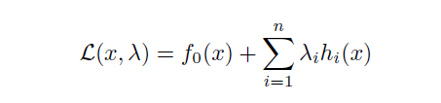
With Multiple Equality Constraints
(n+1) unknowns, (n+1) equations
Can be solved !!

Slide 19
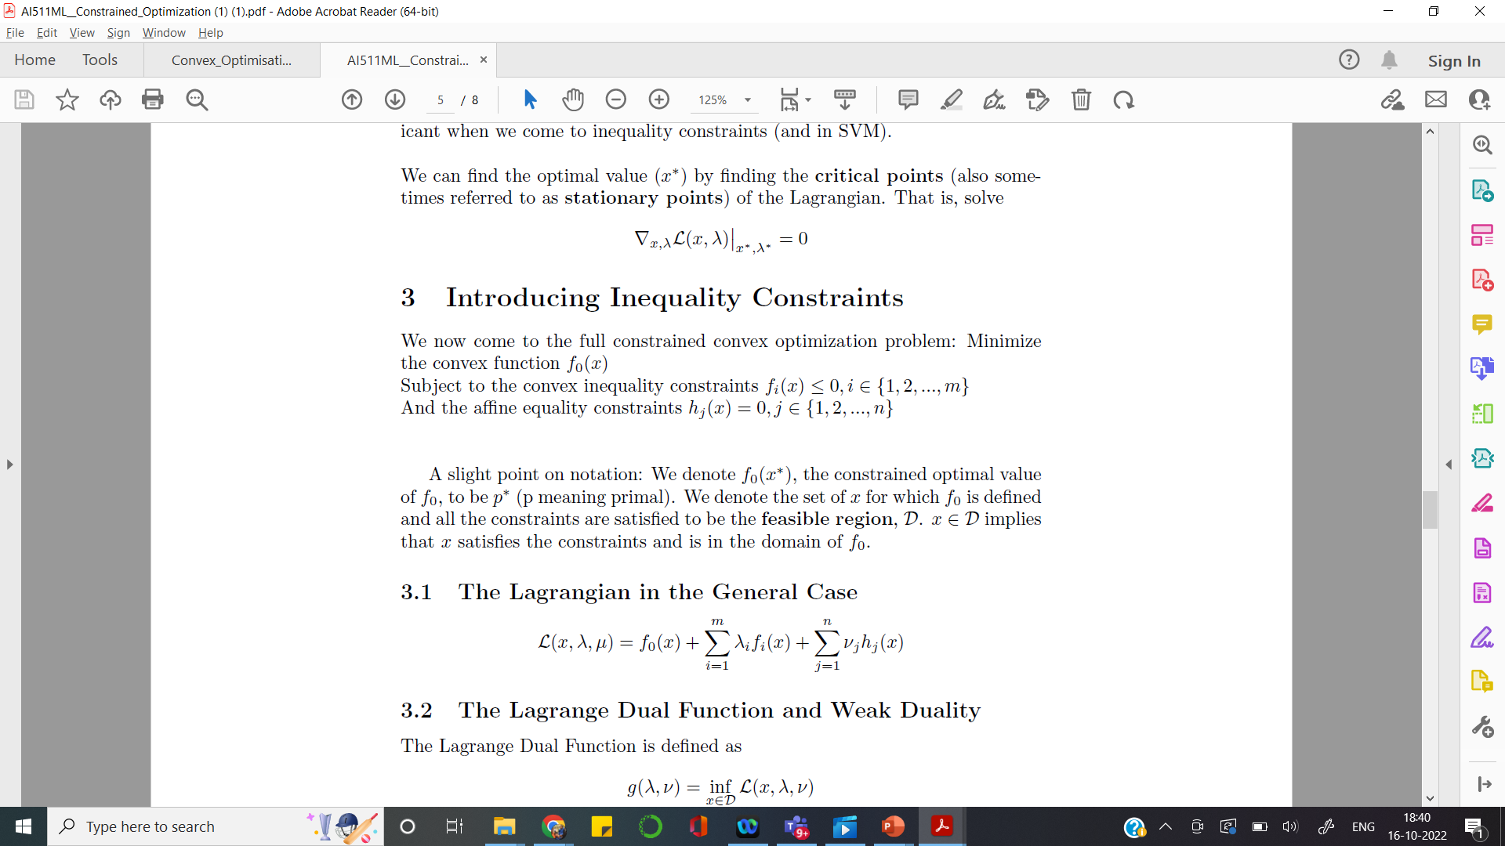
Inequality constraints

Slide 20
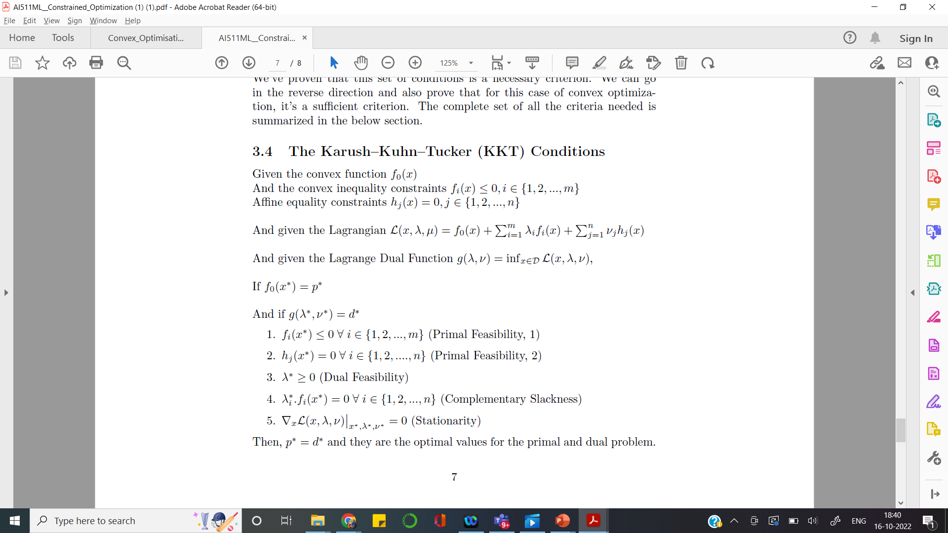
Problem - formulation

Slide 21
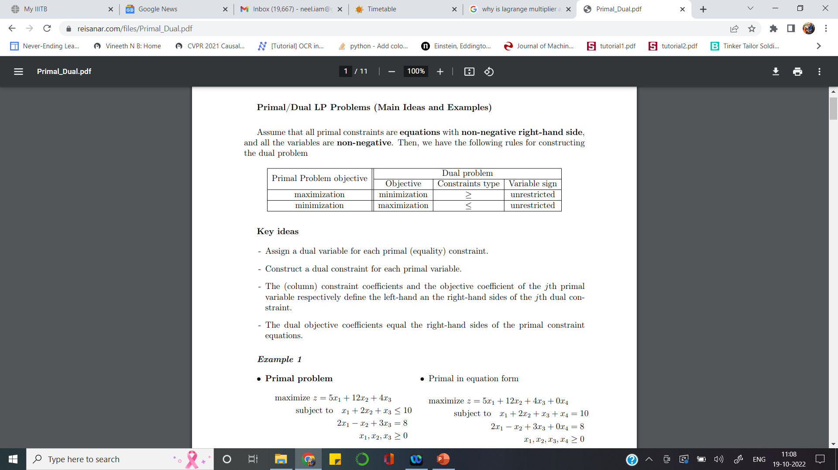
Primal – Dual Conversion

Slide 22
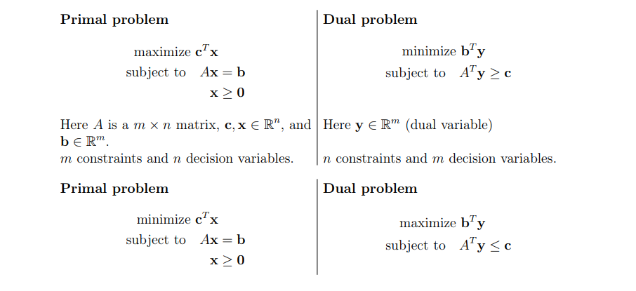
Primal – Dual Conversion

Slide 23
KKT Conditions

Slide 25
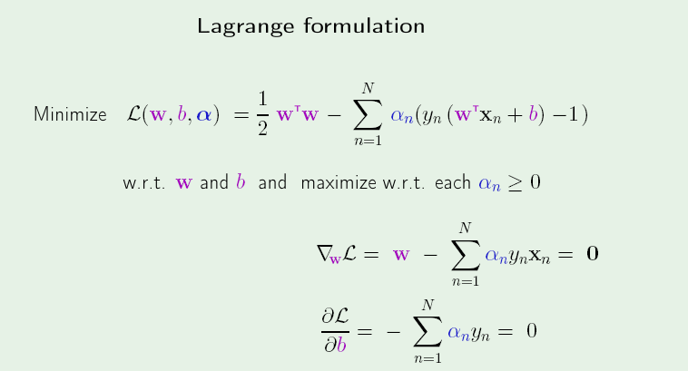
Using Lagrange Optimizers

Slide 26
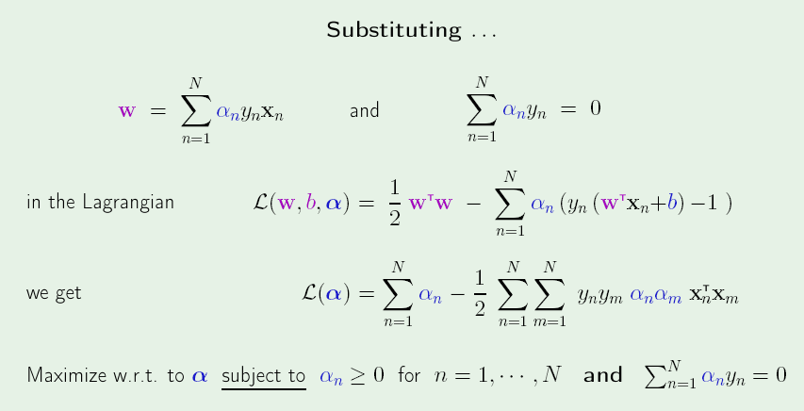
Lagrange Optimization

Slide 27
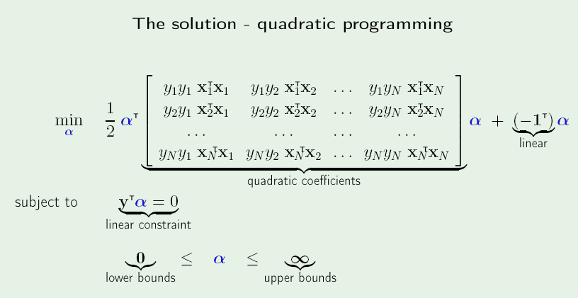
Solution

Slide 28
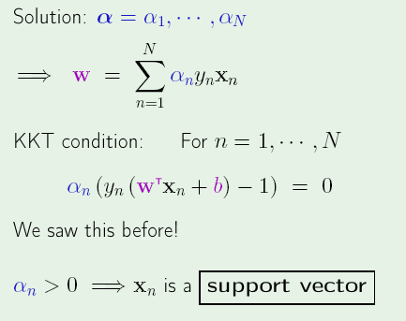
Interpreting weights

Slide 29
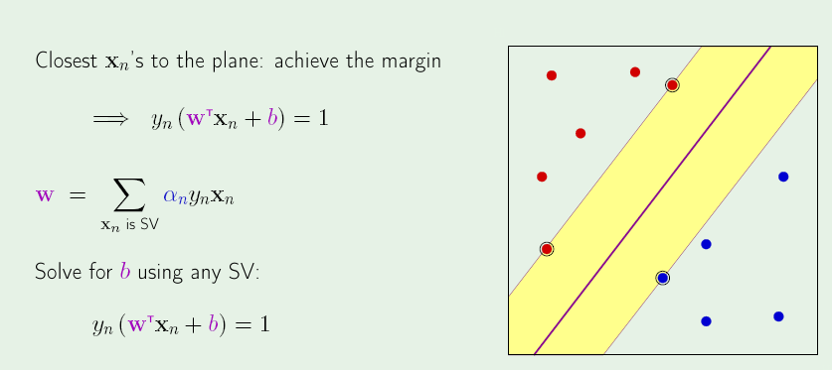
Support Vectors

Slide 30
Good/Bad Cases
Say N = 1000,
Number of SVs = 10
Good situation
Say N = 1000,
Number of SVs = 500
Bad situation

Slide 31
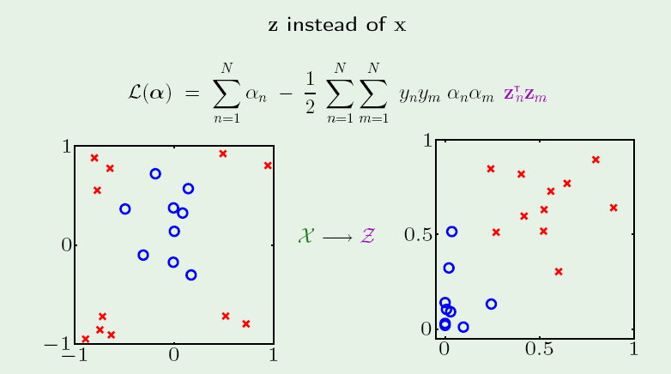
Dot-product structure

Slide 32
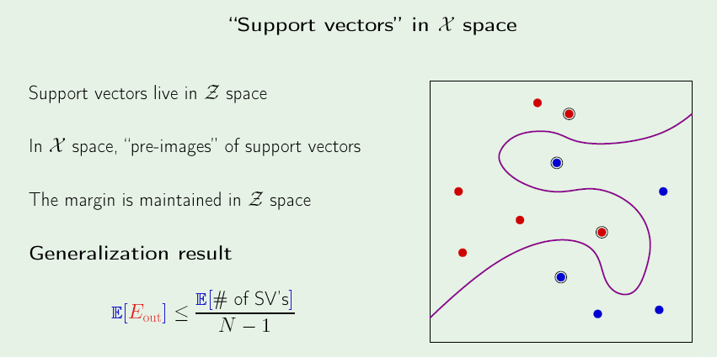
Actual Separator

Slide 33
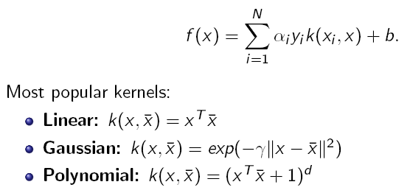
Kernel SVM

Slide 34
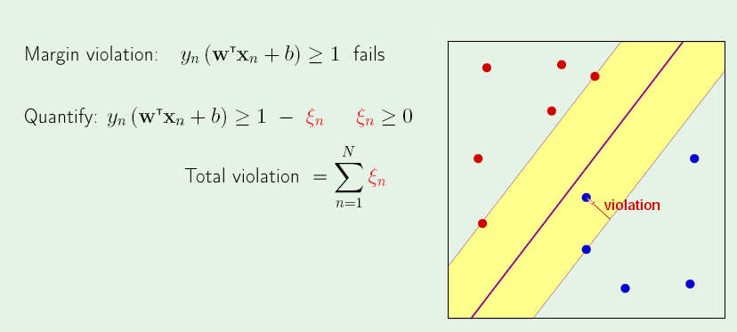
Soft Margin SVM

Slide 35
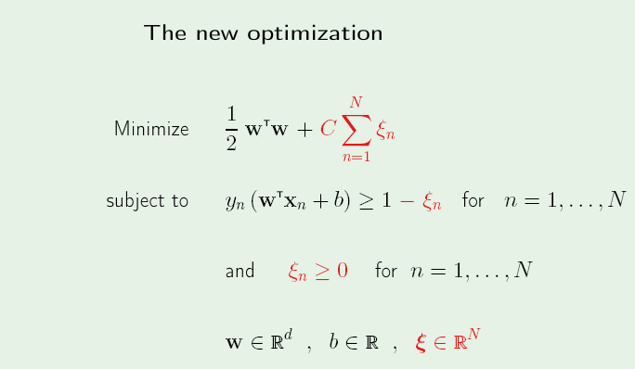

Slide 36
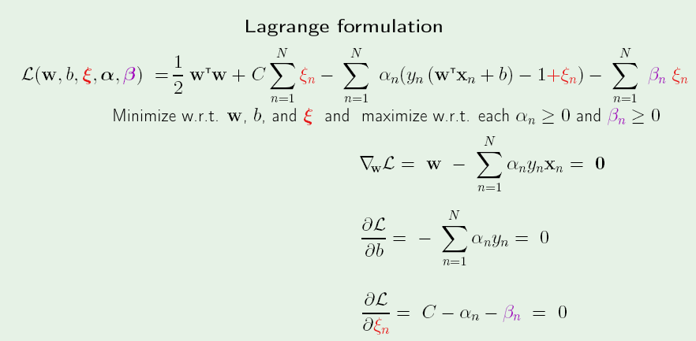

Slide 37
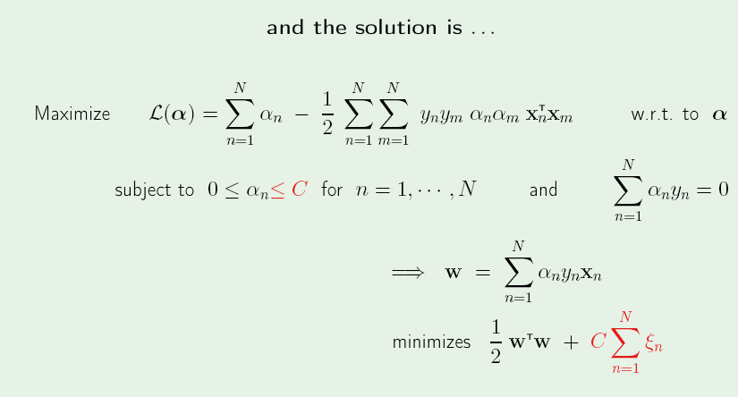

Slide 38
